Slide 1


Set Theory(Types of relations)
LECTURE 8
Adapted from :
https://www.genrica.com/vustuff/MTH202/MTH202_handouts_1_45.pdf

Slide 2
Learning Outcomes
After completing this lecture satisfactorily, a student will:
• Be able to specify and manipulate basic mathematical objects such as sets,
functions, and relations and will also be able to verify simple mathematical
properties that these objects possess.
• Gain experience in using various techniques of mathematical induction (weak,
strong and structural induction) to prove simple mathematical properties of a
variety of discrete structures.

Slide 3
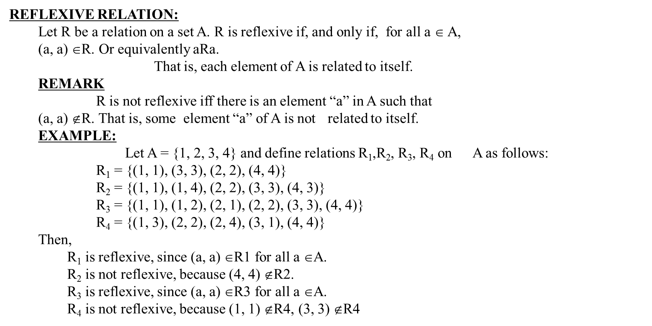

Slide 4
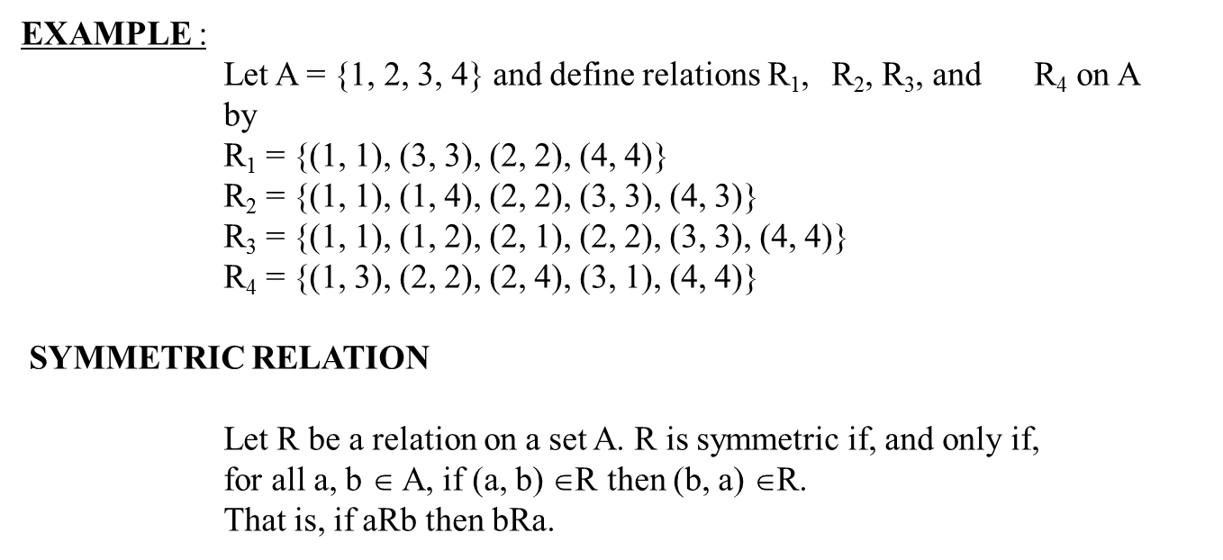

Slide 5
EXAMPLE
Let A = {1, 2, 3, 4} and define relations R₁, R₂, R₃, and R₄on A as follows.
R₁ = {(1, 1), (1, 3), (2, 4), (3, 1), (4,2)}
R₂ = {(1, 1), (2, 2), (3, 3), (4, 4)}
R₃ = {(2, 2), (2, 3), (3, 4)}
R₄ = {(1, 1), (2, 2), (3, 3), (4, 3), (4, 4)}
Then R₁ is symmetric because for every ordered pair (a,b)in R₁awe have (b,a) in R₁for example we have (1,3)in R₁ we have (3,1) in R₁ similarly all other ordered pairs can be checked.
R₂ is also symmetric we say it is vacuously true.
R₃ is not symmetric, because of (2,3) ∈ R₃ but (3,2) ∉ R₃.
R₄ is not symmetric because of (4,3) ∈ R₄ but (3,4) ∉ R₄.

Slide 6
TRANSITIVE RELATION
Let R be a relation on a set A.R is transitive if and only if for all a, b, c ∈A,
if (a, b) ∈R and (b, c) ∈R then (a, c) ∈R.
That is, if aRb and bRc then aRc.
In words, if any one element is related to a second and that second element is related to a third, then the first is related to the third.
Note that the “first”, “second” and “third” elements need not to be distinct.
REMARK
R is not transitive iff there are elements a, b, c in A such that
If (a,b) ∈R and (b,c) ∈R but (a,c) ∉R.

Slide 8
EXERCISE:
Let A = {0, 1, 2} and
R = {(0,2), (1,1), (2,0)} be a relation on A.
Is R reflexive? Symmetric? Transitive?
Which ordered pairs are needed in R to make it a reflexive and transitive relation.
SOLUTION:
R is not reflexive, since 0 ∈ A but (0, 0) ∉R and also 2 ∈ A but (2, 2) ∉R.
R is clearly symmetric. R is not transitive, since (0, 2) & (2, 0) ∈ R but (0, 0) ∉R.
2. For R to be reflexive, it must contain ordered pairs (0,0) and (2,2).
For R to be transitive,
we note (0,2) and (2,0) ∈ but (0,0) ∉R.
Also (2,0) and (0,2) ∈R but (2,2)∉R.
Hence (0,0) and (2,2). Are needed in R to make it a transitive relation.

Slide 14
Review Questions
What is Equivalence relation.
Difference between reflexive and symmetric property

Slide 15
Thank you

